Slide 1
Sales Financial Dashboard
Visual Summary & Key Metrics Overview

Slide 2
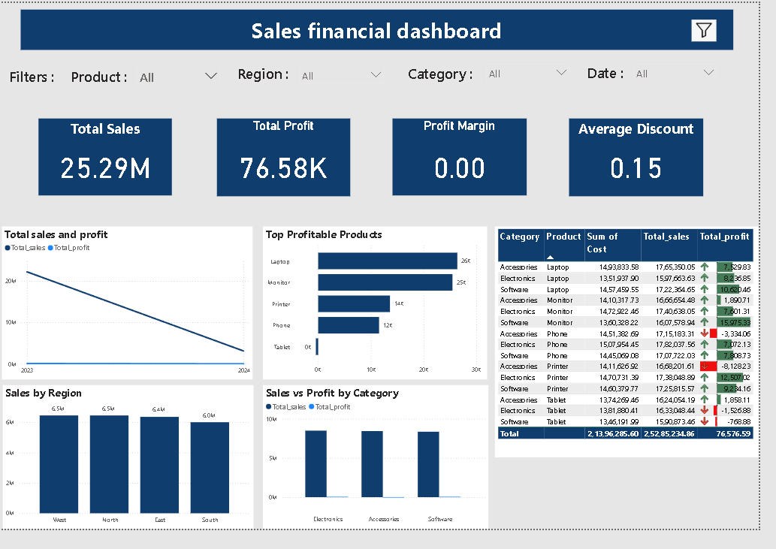

Slide 3
Dashboard Overview
This dashboard provides an overview of sales and financial performance:
• Total Sales: 25.29M - Overall revenue generated.
• Total Profit: 76.58K - Net earnings from sales.
• Profit Margin: 0.00 - Indicates no net margin due to likely cost/sale imbalance.
• Average Discount: 0.15 - Represents average discount across sales transactions.

Slide 4
Visual Insights
• Sales Trend: Sales and profit have dropped from 2023 to 2024.
• Regional Performance: West and North regions lead with over 6.5M in sales.
• Product Profitability: Laptops and Monitors are the top profitable products.
• Category Analysis: Electronics slightly outperform Accessories and Software in sales and profit.
• Detailed Table: Shows individual product performance with green/red profit indicators.

